Slide 1
Game: DEBRIS
This game is Sci-Fi themed.
You are a nomad in a spaceship and have been unfortunate enough to wander into the path of unfriendly aliens.
They have no problem destroying anything in their path and that includes you.
Face them.
Survive.
Live to tell about it.
Daniel

Slide 2
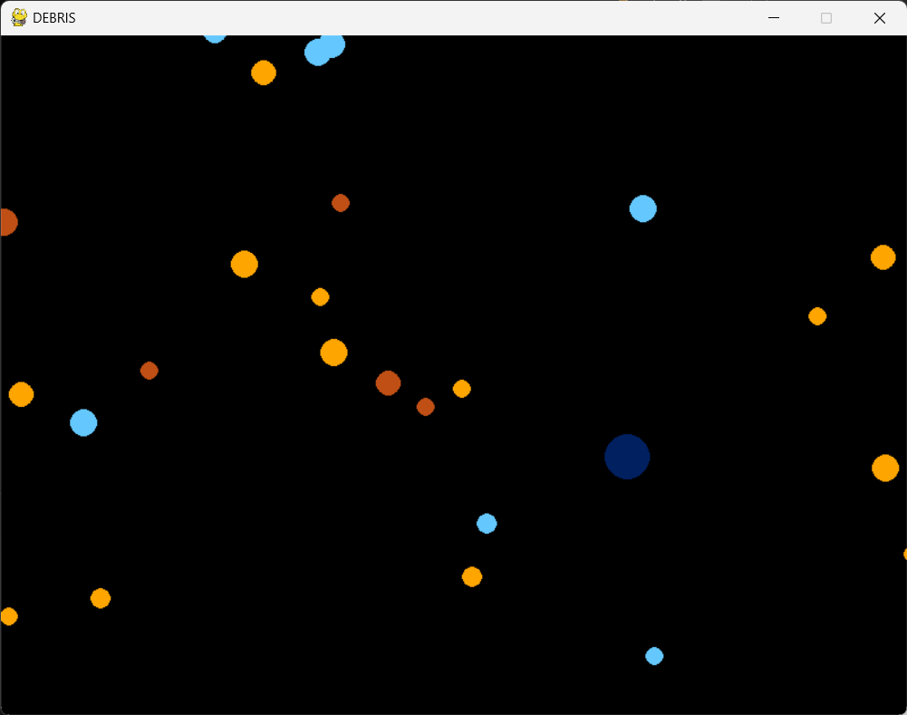
base - v2_p3 - asteroid + player
This stage of the game introduces a player character (dark blue circle) and some asteroids (smaller, brightly coloured circles) that the player must evade.
Player
Daniel

Slide 3
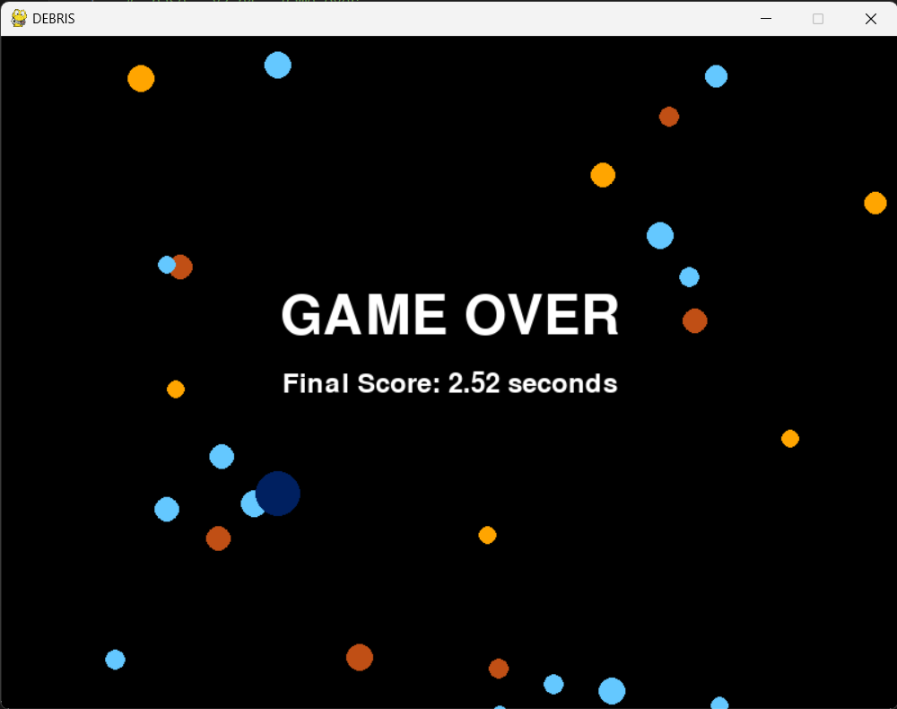
base - v2_p4 - game over
This stage adds a 'game over' feature, expanding on the collision system. In
v2_p3 (version 2 part 3)
Miracle

Slide 4
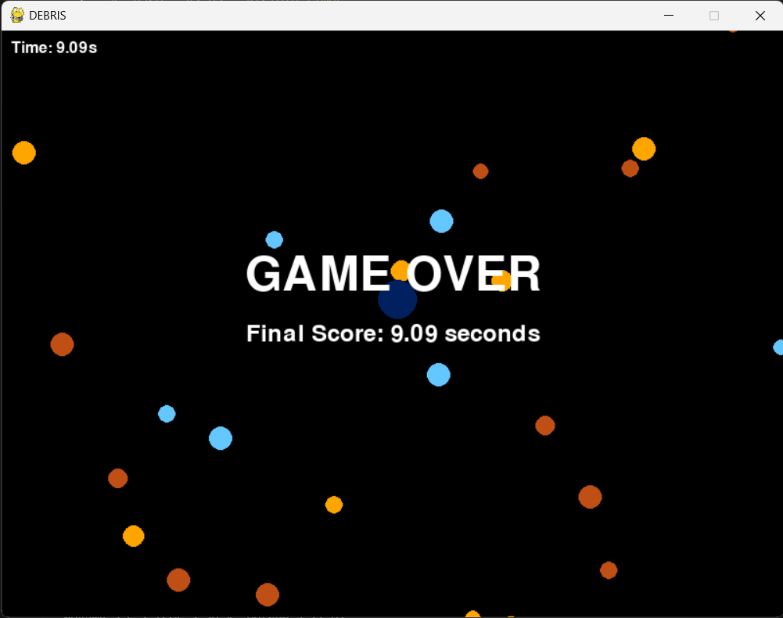
base - v2_p5 - visible timer
This stage of the game makes the timer visible.
Miracle

Slide 5
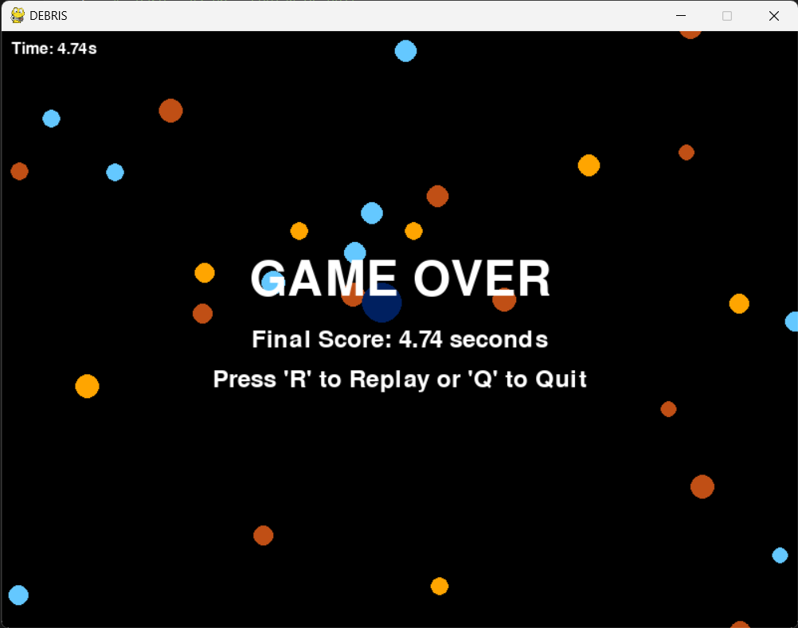
SCREENSHOT GOES HERE
base - v2_p6 - replay or quit
This stage of the game adds a 'replay' or 'quit' feature, letting the player restart or exit without reopening the game.
Miracle

Slide 6
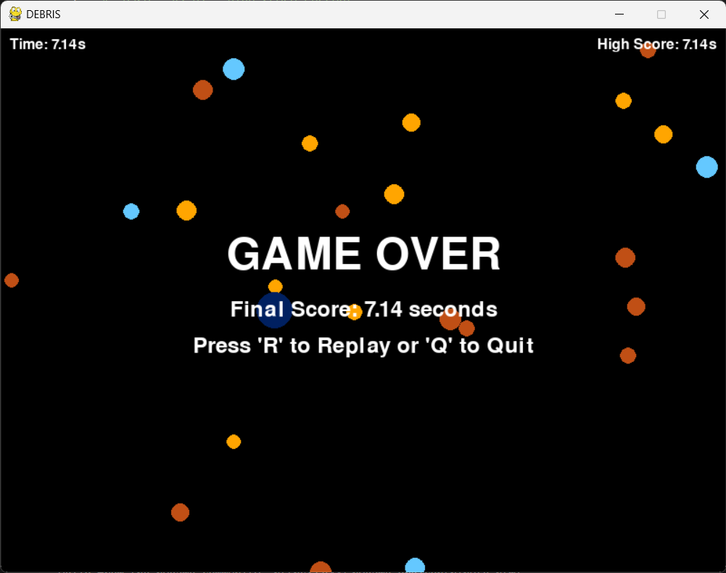
SCREENSHOT GOES HERE
base - v2_p7 - high score current
This stage adds a 'high score' feature that records the players highest score in the current session, updating only if the final score beats the current high score.
Miracle

Slide 7
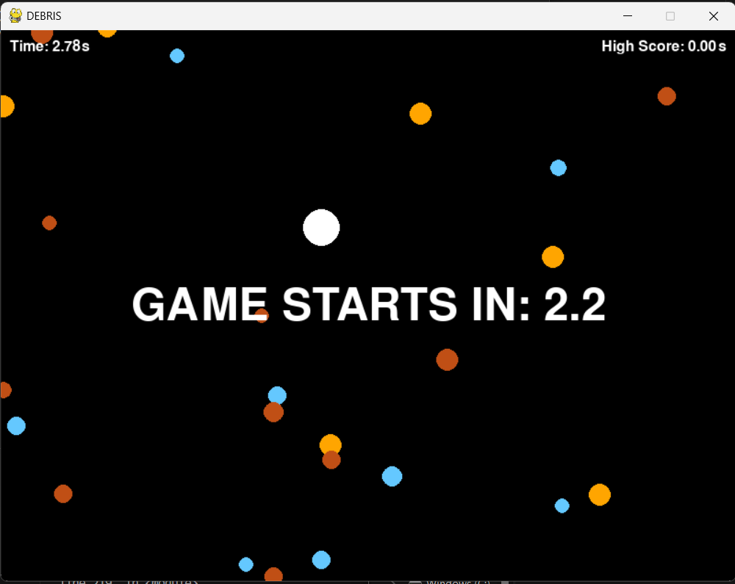
SCREENSHOT GOES HERE
base - v2_p8 - game starts in 321
This stage of the game makes the player invulnerable for the first 5 seconds of the game.
Miracle

Slide 8
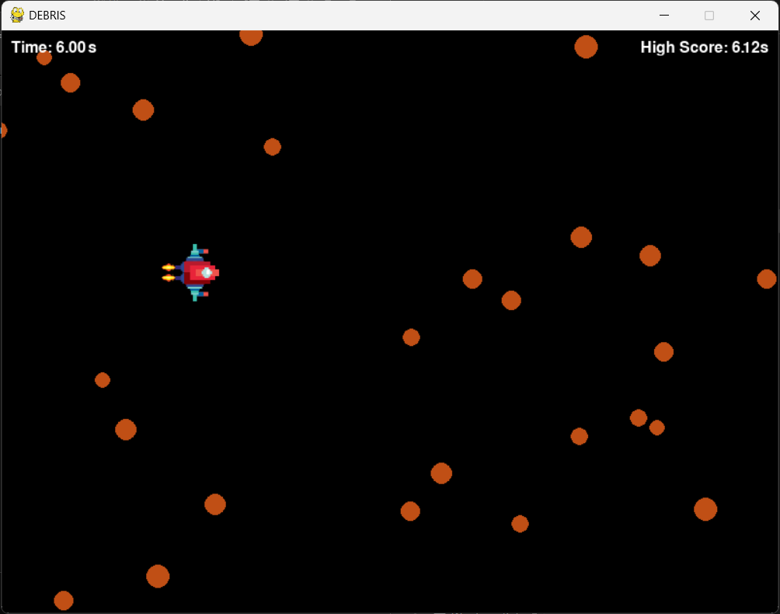
SCREENSHOT GOES HERE
base - v2_p9 - sprite for player
This stage of the game adds more graphics to the game, turning the player into an actual spaceship instead of a dark blue circle.
Miracle

Slide 9
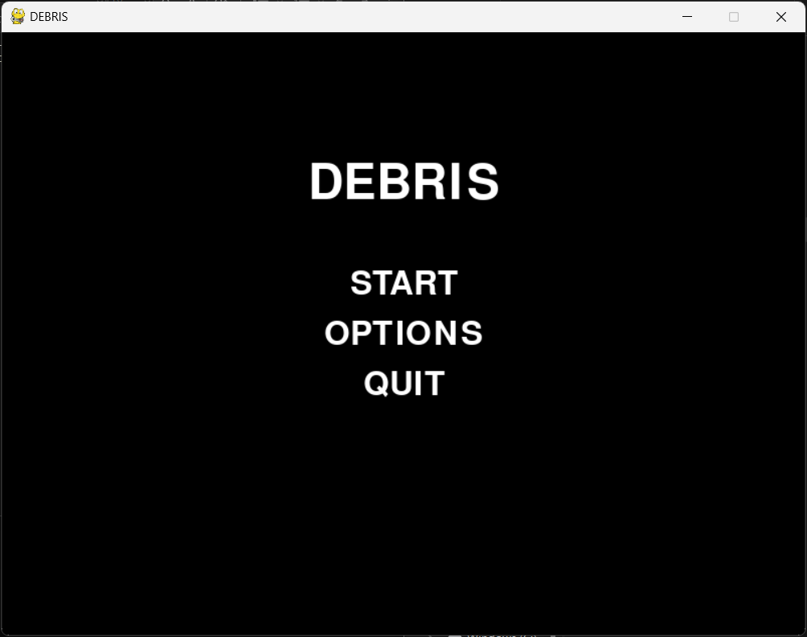
SCREENSHOT GOES HERE
base - v2_p10 - start screen + delayed timer
This stage of the game adds a start screen, which lets the player decide when the game begins.
Dhara

Slide 10
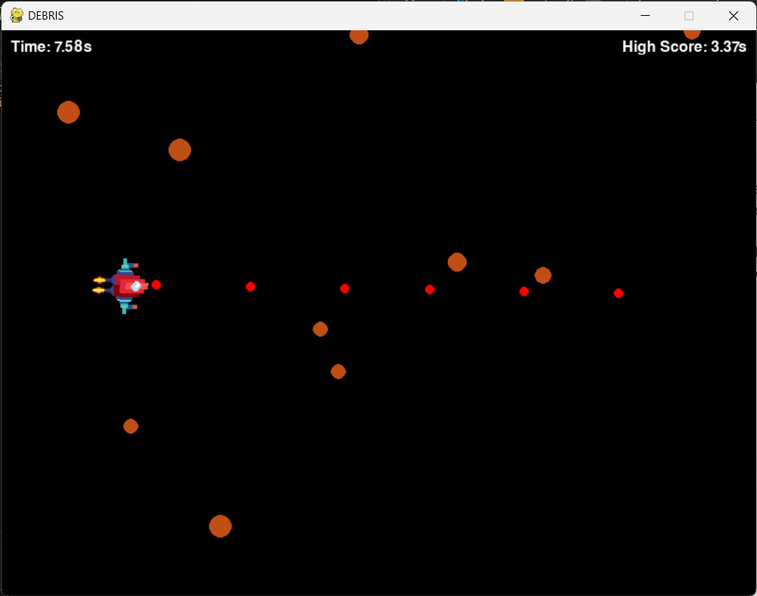
SCREENSHOT GOES HERE
base - v2_p11 - player weaponry L1
This stage of the game gives the player weapons.
Single ‘left-click’ fires a 1 red, circle-shaped attack.
Projectile from player weapons
Dhara

Slide 11
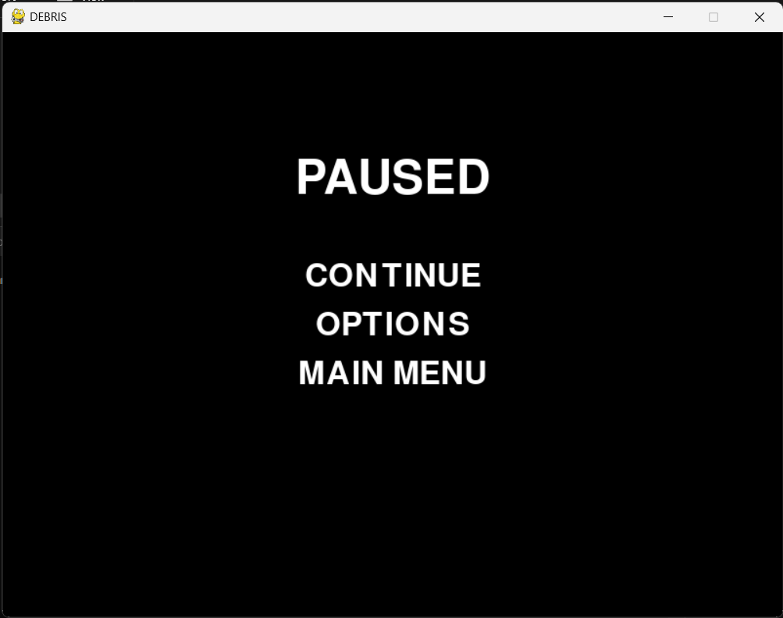
SCREENSHOT GOES HERE
base - v2_p12 - pause continue return
This stage of the game lets the player PAUSE the game and also gives the PAUSE feature a menu.
Dhara

Slide 12
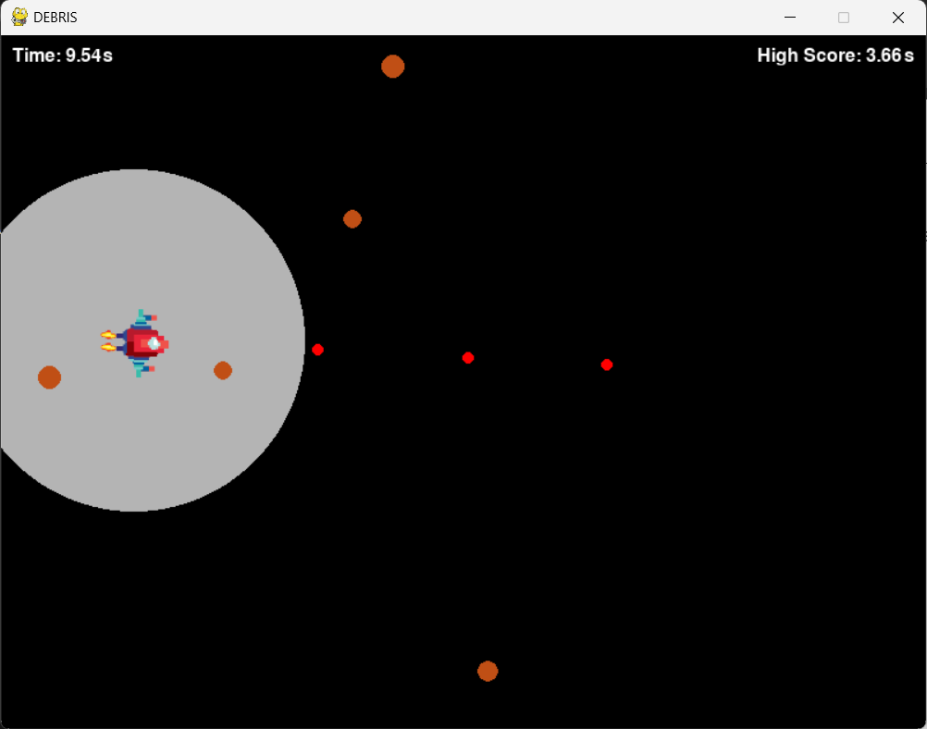
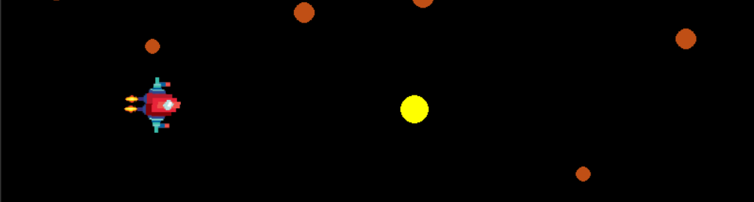
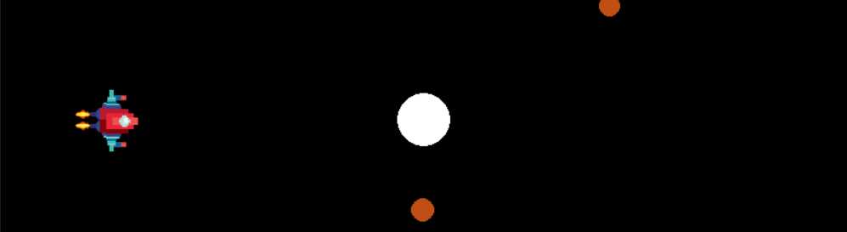
SCREENSHOT GOES HERE
Projectile from player weapons
base - v2_p13 - player weaponry L2
This stage of the game adds more weapons for the player to use.
The player can do this by holding the left mouse button.
The player can fire larger, more powerful attacks by holding left click.
The longer the player holds left click, the more powerful the attack.
Projectile from player weapons
Projectile from player weapons
Dhara

Slide 13
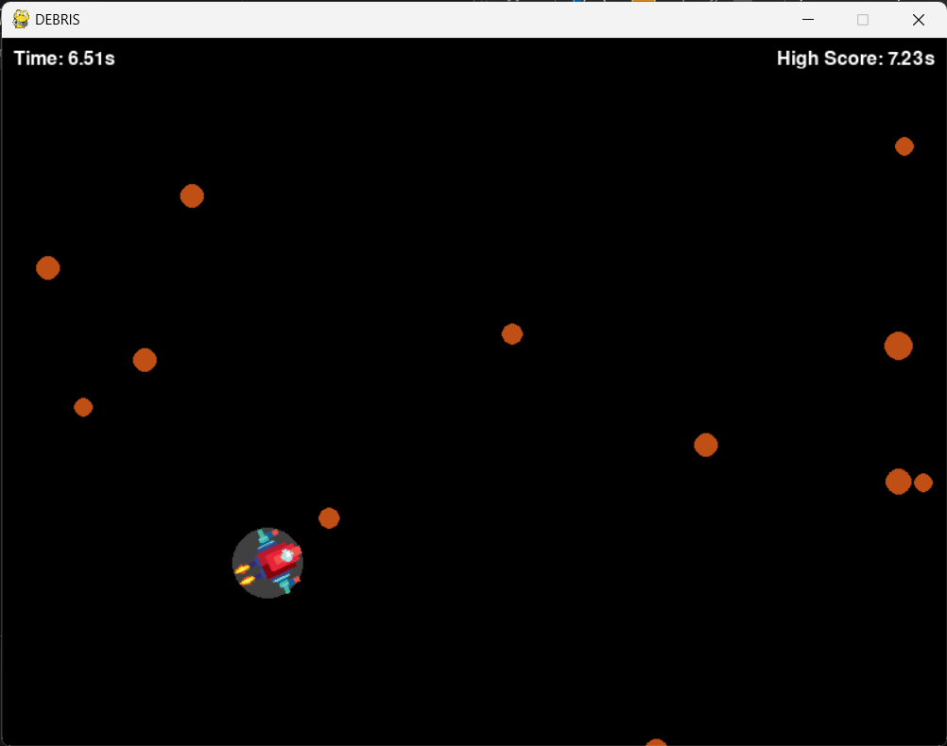
SCREENSHOT GOES HERE
base - v2_p14 - charging effect
This stage of the game adds a visual cue to show that the player is charging an attack.
Dhara

Slide 14
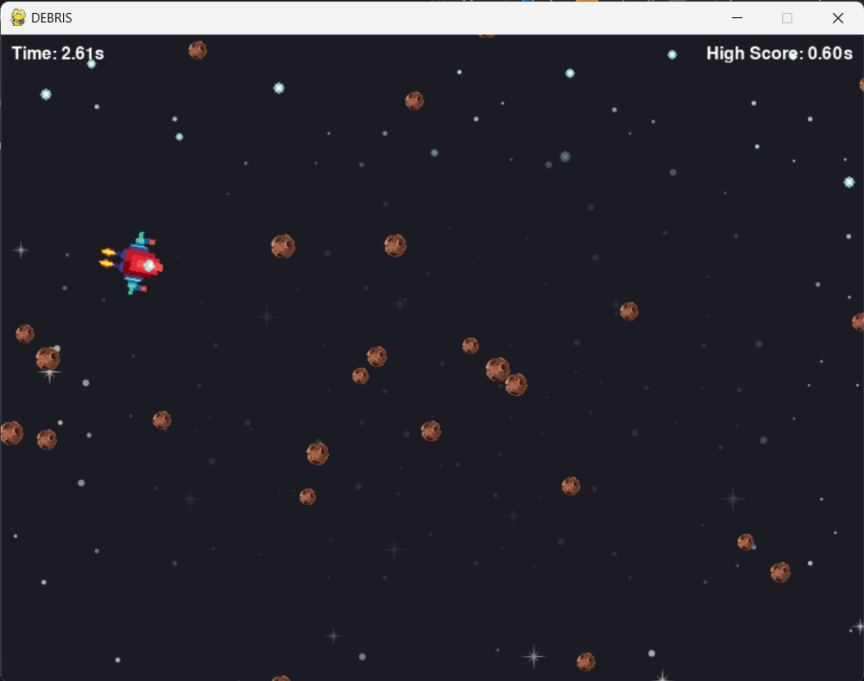
SCREENSHOT GOES HERE
base - v2_p15 - background + real asteroids
This stage of the game adds a nicer background (outer space) and asteroids that actually look like asteroids rather than circles.
Dhara

Slide 15
SCREENSHOT GOES HERE
base - v2_p16 - sound and image fx (malfunctional)
This stage of the game introduces sound fx and enables the destroyed asteroids to briefly transform into exploded versions of themselves.
Samir

Slide 16
SCREENSHOT GOES HERE
base - v2_p17 - sound fx volume modulate
This stage of the game introduces sound effects to the explosions of both the projectiles and the enemies.
Samir

Slide 17
SCREENSHOT GOES HERE
base - v2_p18 - music
This stage of the game introduces background music from the Nitrome game Fat Cat.
It also makes use of game over music from Sonic games.
Samir

Slide 18
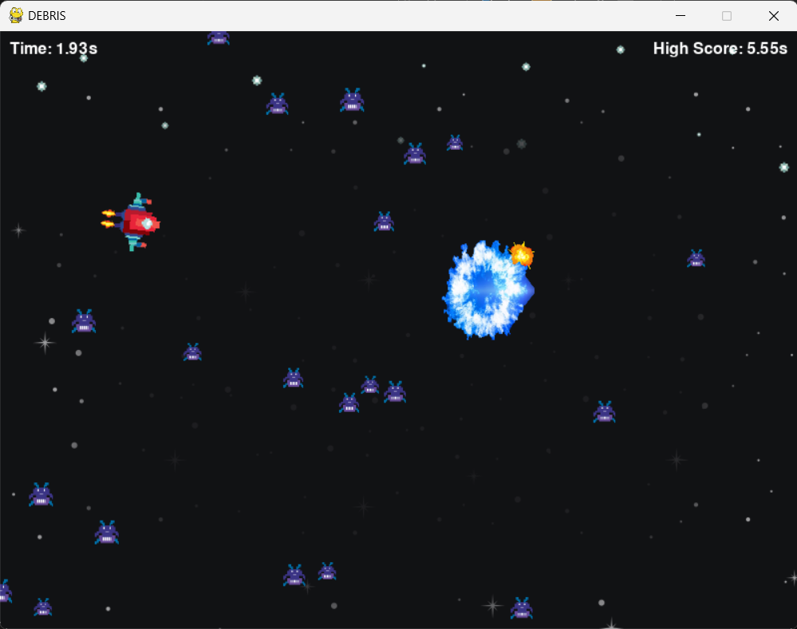
SCREENSHOT GOES HERE
base - v2_p19 - more sprites
This stage of the game turns the asteroids into actual enemies with the appearance of actual enemies.
The projectiles fired by the player have also been modified to appear as actual projectiles rather than mere circles.
Samir

Slide 19
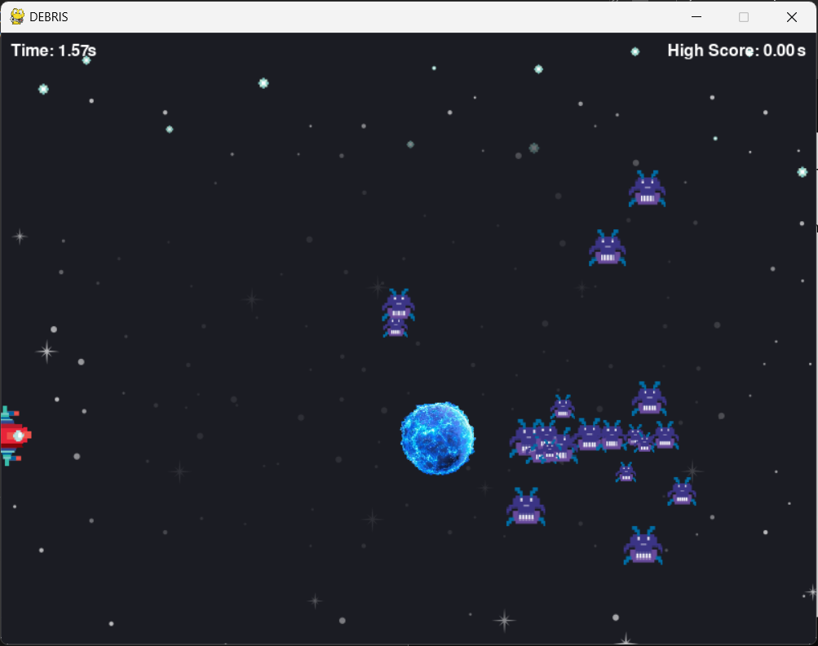
SCREENSHOT GOES HERE
base - v2_p20 - new enemy logic
This stage of the game modifies the initial game mechanics.
Old mechanics: enemies floating randomly throughout the screen.
New mechanics: enemies moving from the right part of the screen to the left, only changing Y axis to follow player.
Samir

Slide 20
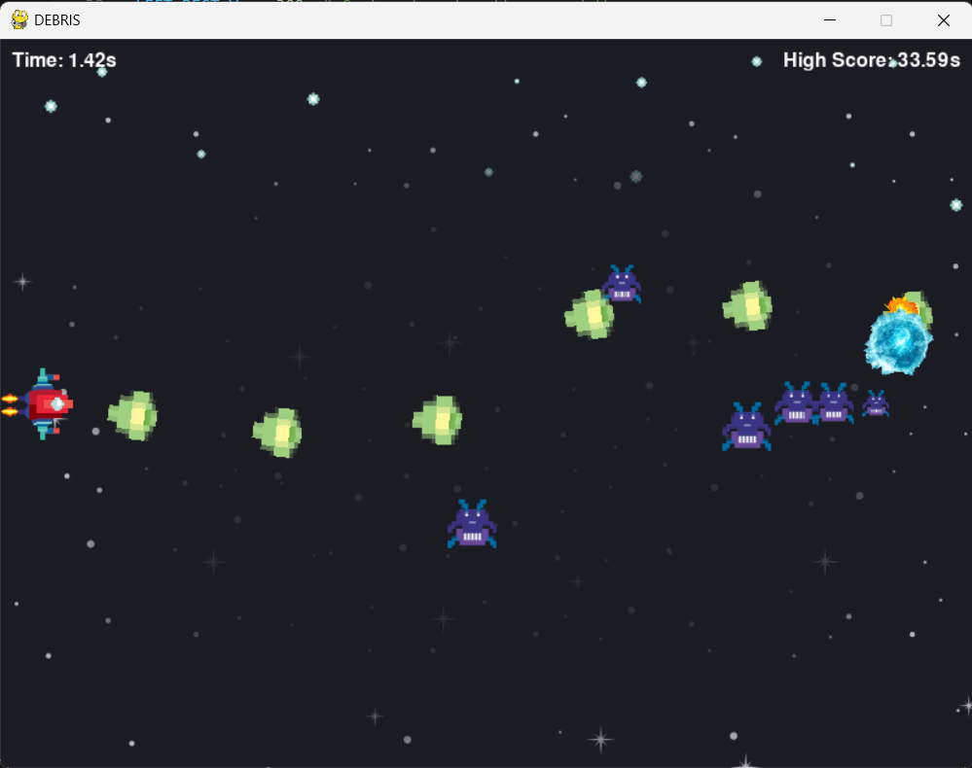
SCREENSHOT GOES HERE
base - v2_p21 - fully auto weapon added
This stage of the game introduces further weaponry, granting the player a fully automatic firing option by holding right click.
Samir

Slide 21
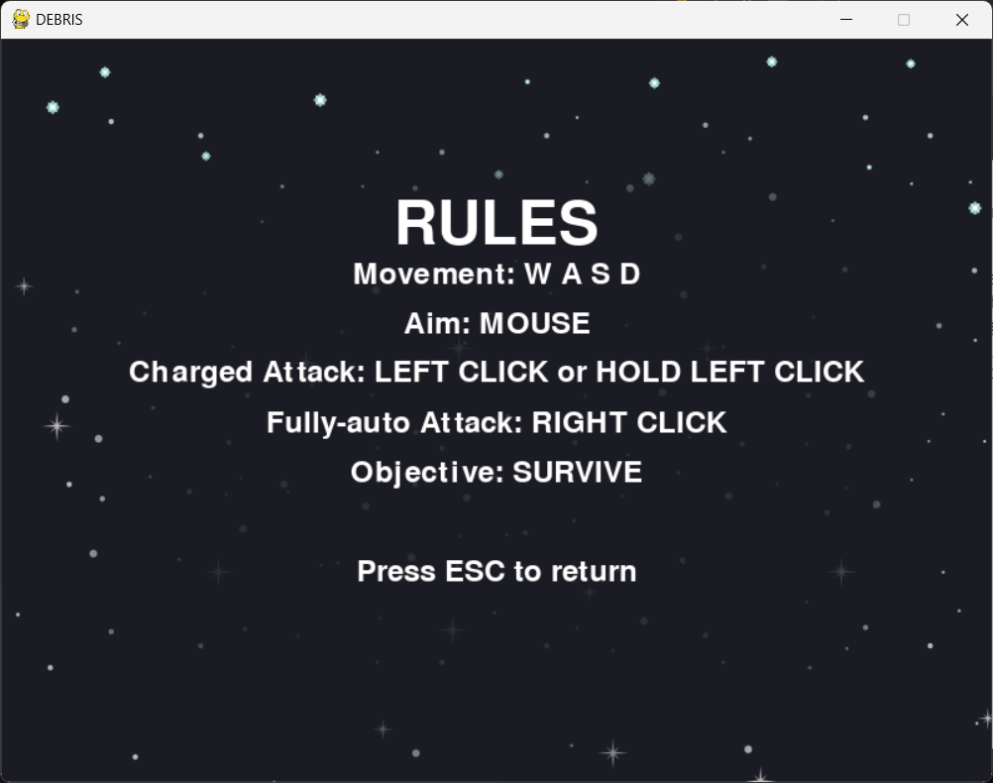
SCREENSHOT GOES HERE
base - v2_p22 - rules of the game
This stage of the game introduces a ‘rules’ menu that enables players to actually have a place they can visit in order to discover the controls of the game.
Samir

Slide 22
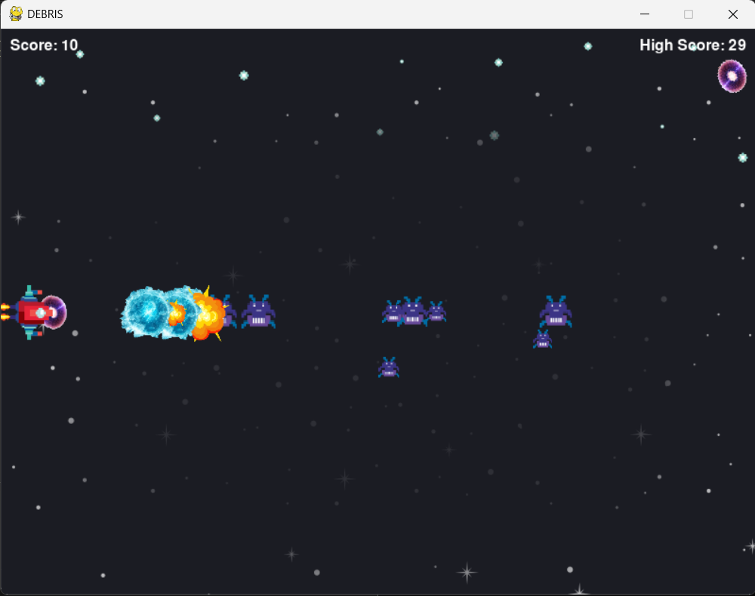
SCREENSHOT GOES HERE
base - v2_p23 - score now = kills
This stage of the game introduces a new score system that places the ‘timer = score’ framework with a ‘kills = score’ framework.
Daniel

Slide 23
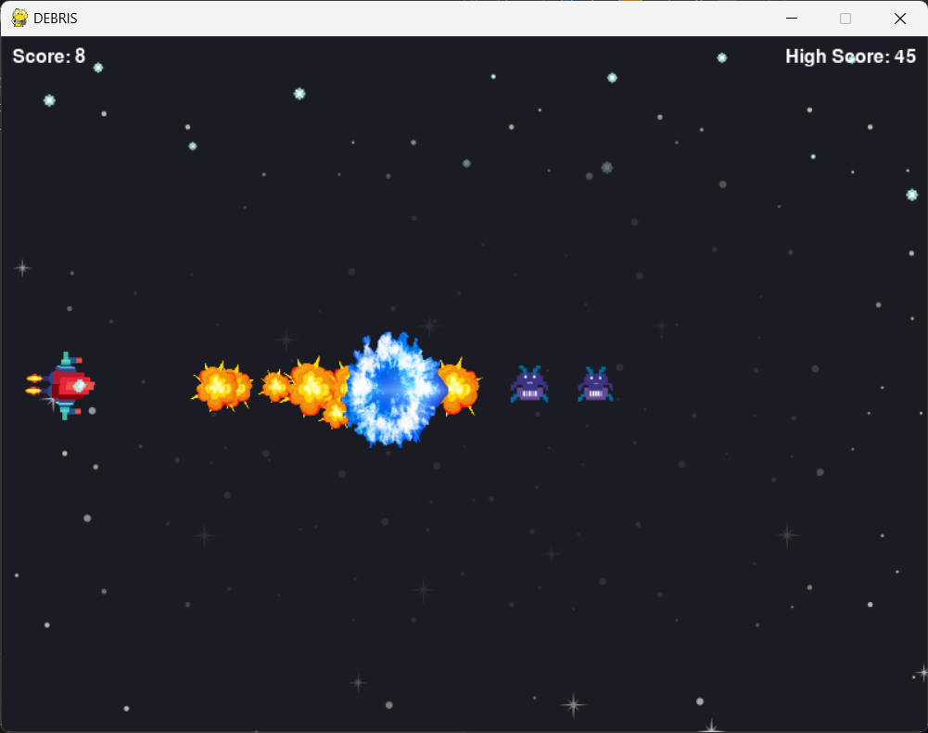
SCREENSHOT GOES HERE
base - v2_p24 - slight weapon improvement
This stage of the game improves the potency of the player’s weaponry, enabling the player to take out more enemies with a single charged shot.
Daniel

Slide 24
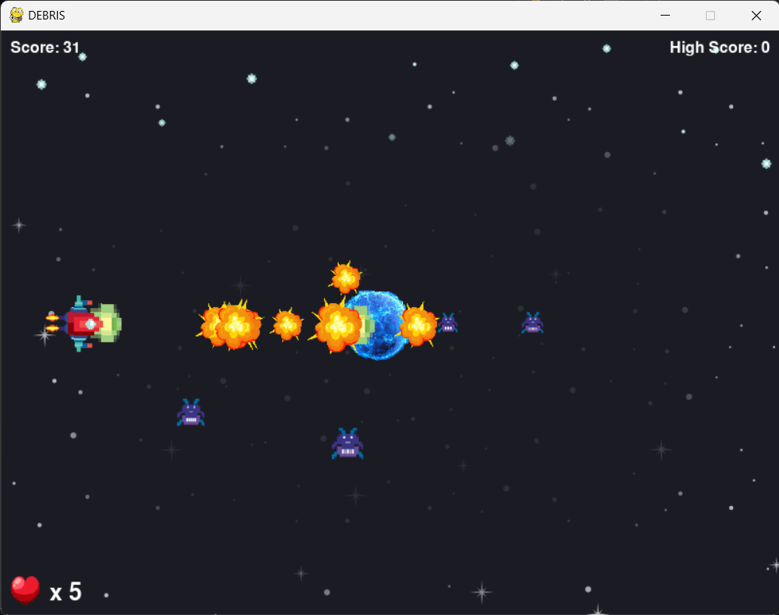
SCREENSHOT GOES HERE
base - v2_p25 - health loss system
This stage of the game introduces a heart counter, a health bar equivalent.
This makes the game a bit less frustrating to play as the player gains 5 hearts, thus 5 opportunities to not get hit by enemies.
Daniel

Slide 25
SCREENSHOT GOES HERE
base - v2_p26 - improved sound fx
This stage of the game introduces more sound effects, giving the parts of the gameplay that still needs sound effect, such as weapon fire and attack charging.
Daniel

Slide 26
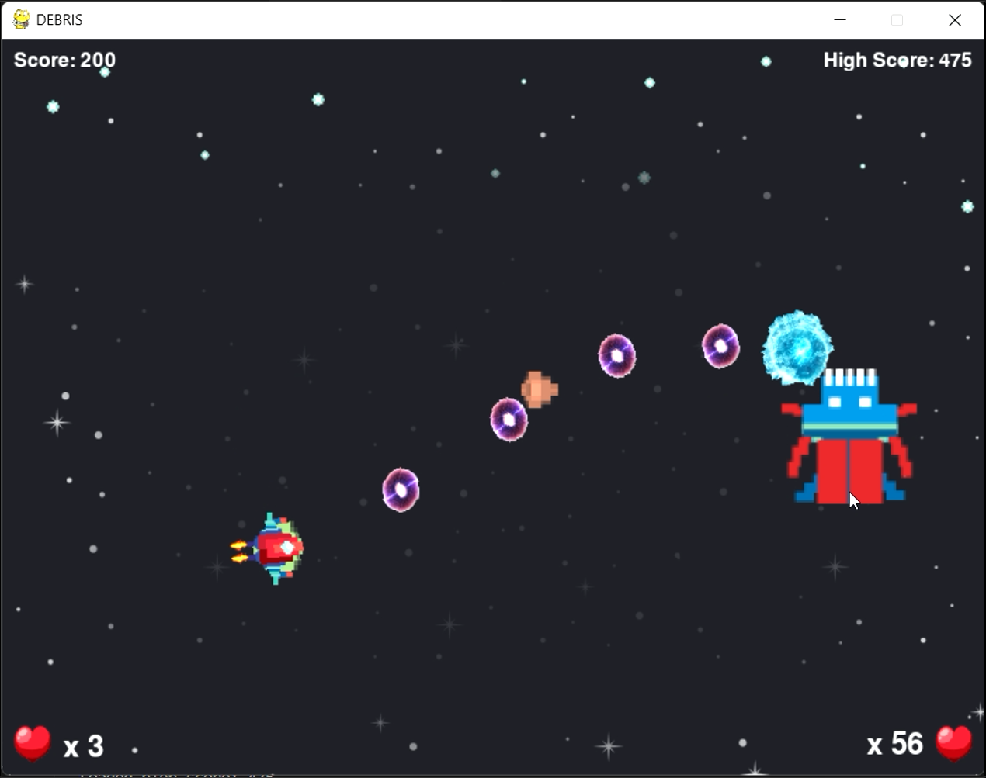
SCREENSHOT GOES HERE
base - v2_p27 - boss fight + music
This stage of the game introduces a boss fight that begins once the player has destroyed a certain number of enemies.
A VICTORY screen, as well as victory music, is also introduced.
Daniel

Slide 27
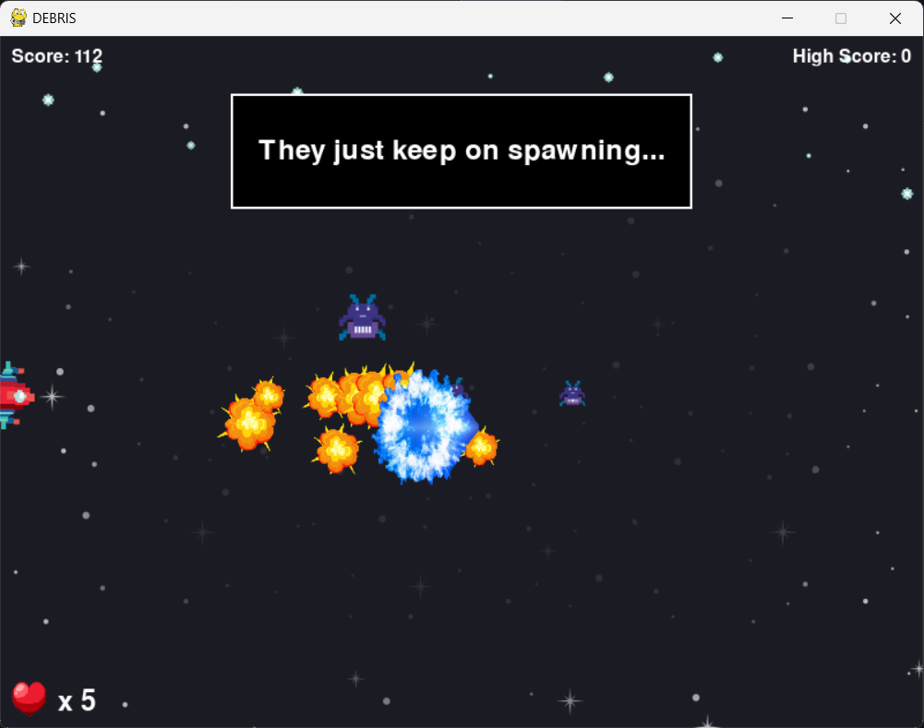
SCREENSHOT GOES HERE
base - v2_p28 - speech boxes
This stage of the game introduces speech boxes which are automatically triggered once the player has defeated a certain number of enemies.
Daniel

Slide 28
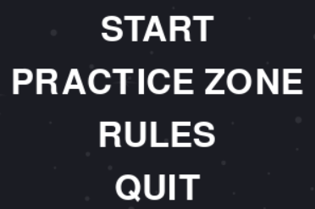
SCREENSHOT GOES HERE
base - v2_p29 - practice zone
This stage of the game introduces a practice zone into the main menu that the player can use to familiarise themselves with the controls of the game before they get to playing.
The practice zone is also a safe zone as there are no enemies at all nor timer.
The player can return from the practice zone to the main menu at any time by pressing ESC key. The practice zone can only be accessed from the main menu, however.
Daniel

Slide 29
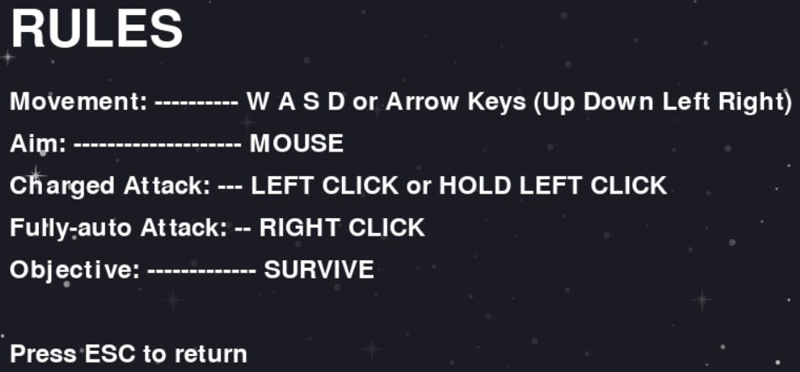
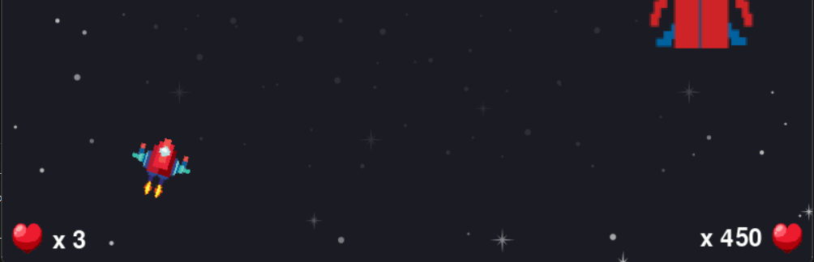
SCREENSHOT GOES HERE
base - v3 - arrow keys + boss health reduced
This stage of the game enables the arrow keys to be used as alternate player controls to the WASD key set, making gameplay more convenient for left-handed people.
The boss’ total health has also been reduced from what it was initially (850 hearts) to 450 hearts, making the boss fight less daunting.

